Slide 1

Noida Institute of Engineering and Technology, Greater Noida
Mobile Application Development
ACSIOT0401
Unit: V
iOS and Swift
SAVITA YADAV
Assistant Professor
IOT Department
Vatika Jalali
Assistant Professor
IoT Department
4th Semester
(IOT)

Slide 2







Faculty Profile
Responsibilities
Faculty IoT,
Mentor IoT
Research Interests
Digital Image processing,
Machine Learning
Ms. Vatika Jalali
Assistant Professor, IoT
Education
M.Tech CSE, PTU
B.Tech CSE, HPTU
Publications
Research Paper: 4
Work Exp.
NIET, Gr. Noida (September, 2022 to till date)
Worked at Chandigarh University
Ms. Vatika Jalali Mobile Application Development Unit-5

Slide 3
Evaluation Scheme
Sl. No. | Subject Codes | Subject Name | Periods |  |  | Evaluation Scheme |  |  |  | End Semester |  | Total | Credit
 |  |  | L | T | P | CT | TA | TOTAL | PS | TE | PE
1 | AAS0402 | Engineering Mathematics- IV | 3 | 1 | 0 | 30 | 20 | 50 |  | 100 |  | 150 | 4
2 | AASL0401 | Technical Communication | 2 | 1 | 0 | 30 | 20 | 50 |  | 100 |  | 150 | 3
3 | ACSE0403B | Operating Systems | 3 | 0 | 0 | 30 | 20 | 50 |  | 100 |  | 150 | 3
4 | ACSAI0402 | Database Management Systems | 3 | 1 | 0 | 30 | 20 | 50 |  | 100 |  | 150 | 4
5 | ACSIOT0401 | Mobile Application Development | 3 | 0 | 0 | 30 | 20 | 50 |  | 100 |  | 150 | 3
6 | ACSE0404 | Theory of Automata and Formal Languages | 3 | 0 | 0 | 30 | 20 | 50 |  | 100 |  | 150 | 3
7 | ACSE0453B | Operating Systems Lab | 0 | 0 | 2 |  |  |  | 25 |  | 25 | 50 | 1
8 | ACSAI0452 | Database Management Systems Lab | 0 | 0 | 2 |  |  |  | 25 |  | 25 | 50 | 1
9 | ACSIOT0451 | Mobile Application Development Lab | 0 | 0 | 2 |  |  |  | 25 |  | 25 | 50 | 1
10 | ACSE0459 | Mini Project using Open Technology | 0 | 0 | 2 |  |  |  | 50 |  |  | 50 | 1
11 | ANC0402 / ANC0401 | Environmental Science*/ Cyber Security*(Non Credit) | 2 | 0 | 0 | 30 | 20 | 50 |  | 50 |  | 100 | 0
 |  | MOOCs** (For B.Tech. Hons. Degree)
 |  | GRAND TOTAL |  |  |  |  |  |  |  |  |  | 1100 | 24

Slide 4
Syllabus
Course Contents / Syllabus
UNIT-I | Introduction to Mobile Application and Architecture | 8 Hours
Mobile applications, History of mobile application frameworks, Characteristics and types of mobile applications, Achieving quality constraints. Mobile Architecture- Mobile Hardware Architecture: processors used for Mobile and Handheld devices and SoC architecture; Mobile Software Architecture: Real Time Operating systems and Mobile Real Time Operating Systems, SDK’s.
UNIT-II | Android Developing Environment | 6 Hours
Introduction to Android, Android ecosystem, Android SDK and Installation, Layered Architecture of Android, Android API levels (versions & version names), Android Development Tools, Basic Building blocks – Protocols, Activities, Services, Broadcast Receivers & Content providers.
UNIT-III | UI Components and Multimedia | 10 Hours
Fundamental UI design, layout and view types, Interaction with server-side applications – Using Google Maps, GPS and Wi-Fi, Integration with social media applications, Interfacing sensor data with mobile application, Accessing applications hosted in a cloud computing environment. Multimedia Supported audio and video formats, Audio capture, Bluetooth, Animation.

Slide 5
Syllabus
UNIT-IV | Android Application Deployment | 8 Hours
Persisting data using SQLite database, Testing and debugging Android Application, Packaging and Android Application Deployment on device with Windows, Android Permissions. Testing and publishing of Mobile Applications on different app stores.
UNIT-V | iOS and Swift | 8 Hours
Introduction to Objective C, iOS features, UI implementation, Touch frameworks, Data persistence using Core Data and SQLite, Location aware applications using Core Location and Map Kit, integrating calendar and address book with social media application, using Wifi - iPhone marketplace. Swift: Introduction to Swift, Features of swift.

Slide 6
Branch wise Applications
A mobile app is a medium between an IoT device and a mobile phone.
The app works as the primary interface through which we can manage smart things.
Mobile IoT apps supplement and enhance the use of IoT to make it work more efficiently.

Slide 7
Course Objective
This course introduces students to programming technologies, design and development related to mobile applications using android/ iOS.
Course also aims at mobile application development frameworks; mobile architecture, design and engineering issues, techniques, methodologies for mobile application development.

Slide 8


Course Outcomes
Course outcomes : After completion of this course students will be able to
CO 1 | Recall vision, definition, conceptual framework, architecture of mobile applications. | K1
CO 2 | Describe and configure android development environment, tools, and architecture. | K2
CO 3 | Create and implement UI components and multimedia framework, fragments, audio capture, animation, and other activities. | K6
CO 4 | Integrate and interact with server-side applications with testing and deployment of android application. | K3
CO 5 | Analyze iOS and swift features, frameworks, map kit, and social media applications. | K4

Slide 9
CO-PO Mapping
Mapping of Course Outcomes and Program Outcomes:
CO.k | PO1 | PO2 | PO3 | PO4 | PO5 | PO6 | PO7 | PO8 | PO9 | PO10 | PO11 | PO12
ACSIOT0401.1 | 3 | 3 | 1 | 3 | 2 | 1 | 1 | 3 | 1 | 2 | 2 | 2
ACSIOT0401.2 | 3 | 3 | 2 | 3 | 3 | 2 | 3 | 3 | 2 | 2 | 3 | 2
ACSIOT0401.3 | 3 | 3 | 2 | 3 | 3 | 3 | 3 | 3 | 2 | 2 | 3 | 3
ACSIOT0401.4 | 3 | 3 | 2 | 3 | 2 | 1 | 1 | 3 | 1 | 1 | 2 | 2
ACSIOT0401.5 | 3 | 3 | 2 | 3 | 3 | 2 | 3 | 3 | 2 | 2 | 3 | 2
Average | 3 | 3 | 1.8 | 3 | 2.6 | 1.8 | 2.4 | 3 | 1.8 | 1.8 | 2.6 | 2.2
3= High, 2=Medium, 1=Low

Slide 10
Result Analysis
Subject | No. of students | Min Marks | Max Marks | Over all Result
Mobile Application Development | 40 | 30 | 80 | 95%

Slide 11
Ge
End Semester Question paper Templates
General Instructions:
All questions are compulsory. Answers should be brief and to the point.
This Question paper consists of …………pages & …8………questions.
It comprises of three Sections, A, B, and C. You are to attempt all the sections.
Section A -Question No- 1 is objective type questions carrying 1 mark each, Question No- 2 is very short
answer type carrying 2 mark each. You are expected to answer them as directed.
Section B - Question No-3 is Long answer type -I questions with external choice carrying 6 marks each.
You need to attempt any five out of seven questions given.
Section C - Question No. 4-8 are Long answer type –II (within unit choice) questions carrying 10 marks
each. You need to attempt any one part a or b.
Students are instructed to cross the blank sheets before handing over the answer sheet to the invigilator.
No sheet should be left blank. Any written material after a blank sheet will not be evaluated/checked.

Slide 12
 |  | SECTION – A |  | CO
 | Attempt all parts- |  | [10×1=10]
 | 1-a. | Question- | (1)
 | 1-b. | Question- | (1)
 | 1-c. | Question- | (1)
 | 1-d. | Question- | (1)
 | 1-e. | Question- | (1)
 | 1-f. | Question- | (1)
 | 1-g. | Question- | (1)
 | 1-h. | Question- | (1)
 | 1-i. | Question- | (1)
 | 1-j. | Question- | (1)
2. | Attempt all parts- |  | [5×2=10] | CO
 | 2-a. | Question- | (2)
 | 2-b. | Question- | (2)
 | 2-c. | Question- | (2)
 | 2-d. | Question- | (2)
 | 2-e. | Question- | (2)

Slide 13
SECTION – B |  |  |  | CO
3. | Answer any five of the following- |  | [5×6=30]
 | 3-a. | Question- | (6)
 | 3-b. | Question- | (6)
 | 3-c. | Question- | (6)
 | 3-d. | Question- | (6)
 | 3-e. | Question- | (6)
 | 3-f. | Question- | (6)
 | 3-g. | Question- | (6)
SECTION – C |  |  |  | CO
4 | Answer any one of the following- |  | [5×10=50]
 | 4-a. | Question- | (10)
 | 4-b. | Question- | (10)
5. | Answer any one of the following-
 | 5-a. | Question- | (10)
 | 5-b. | Question- | (10)
6. | Answer any one of the following-
 | 6-a. | Question- | (10)
 | 6-b. | Question- | (10)
7. | Answer any one of the following-
 | 7-a. | Question- | (10)
 | 7-b. | Question- | (10)
8. | Answer any one of the following-
 | 8-a. | Question- | (10)
 | 8-b. | Question- | (10)

Slide 14
Prerequisites
Overview of object oriented programming concepts
C basics

Slide 15
Brief Introduction about the Subject with videos
Mobile application development is the process of creating software applications that run on a mobile device, and a typical mobile application utilizes a network connection to work with remote computing resources.
Hence, the mobile development process involves creating installable software bundles (code, binaries, assets, etc.) , implementing backend services such as data access with an API, and testing the application on target devices.
https://www.youtube.com/watch?v=bOiCw-ZZlGA
https://www.youtube.com/watch?v=09TeUXjzpKs&t=5270s

Slide 16
Recap of unit 4
Discussed about the persisting data using SQLite database
Testing and debugging Android Application covered.
Discussed the packaging on device with Windows
Android Application Deployment on device with Windows covered
Android Permissions discussed
Testing and publishing of Mobile Applications on different app stores discussed.

Slide 17
Unit Contents
Introduction to Objective C
iOS features
UI implementation
Touch frameworks
Data persistence using Core Data and SQLite
Location aware applications using Core Location and Map Kit
Integrating calendar and address book with social media application
Using Wifi - iPhone marketplace.
Swift: Introduction to Swift
Features of swift.

Slide 18
Unit Objective
To understand key concepts of iOS and features.
To know the basics of Objective C.
To understand the concept of UI implementation and touch frameworks
To understand the concept of various applications like location based, calendar, address book integration with social media application
To know about introduction to Swift and features.

Slide 19
Introduction to iOS
Topic Objective: Understanding the concept of iOS and versions
iOS is the name of the operating system that runs the iPhone and iPod touch.
It's the core software that comes loaded on all devices to allow them to run and support other apps.
The iOS is to the iPhone what Windows is to PCs or macOS is to Macs.
It was first called “iPhone OS” for the first 3 years (2007-2009) later on from 2010 the Operating system was renamed “iOS“.
The Operating system was first released on 29 June 2007 with the first phone from Apple known as “iPhone”

Slide 20
iOS Versions
Version | Build No. | Architecture | Last Update | End Of Life
1.1.4 | 4A102 | 32-bit ARM | 26 Feb 2008 | N/A
2.2.1 | 5H11 | 32-bit ARM | 27 Jan 2009 | N/A
3.1.3 | 7E18 | 32-bit ARM | 02 Feb 2010 | iPhone 1st Gen
3.1.3 | 7E18 | 32-bit ARM | 02 Feb 2010 | iPod 1st Gen
4.3.5 | 8L1 | 32-bit ARM | 25 July 2011 | iPhone 3G
4.3.5 | 8L1 | 32-bit ARM | 25 July 2011 | iPod 2nd Gen
5.1.1 | 9B206 | 32-bit ARM | 07 May 2012 | iPad 1st Gen
5.1.1 | 9B206 | 32-bit ARM | 07 May 2012 | iPod 3rd Gen
6.1.6 | 10B500 | 32-bit ARM | 21 Feb 2014 | iPhone 3GS
6.1.6 | 10B500 | 32-bit ARM | 21 Feb 2014 | iPod 4th Gen
7.1.2 | 11D257 | 32/64-bit ARM | 30 Jun 2014 | iPhone 4
8.4.1 | 12H321 | 32/64-bit ARM | 13 Aug 2015 | N/A
9.3.6 | 13G37 | 32/64-bit ARM | 22 July 2019 | iPhone 4S
9.3.6 | 13G37 | 32/64-bit ARM | 22 July 2019 | iPad Mini
9.3.6 | 13G37 | 32/64-bit ARM | 22 July 2019 | iPad 2nd Gen
9.3.6 | 13G37 | 32/64-bit ARM | 22 July 2019 | iPad 3rd Gen
9.3.6 | 13G37 | 32/64-bit ARM | 22 July 2019 | iPod 5th Gen
10.3.3 | 14G60 | 32/64-bit ARM | 19 July 2017 | iPhone 5C
10.3.3 | 14G60 | 32/64-bit ARM | 19 July 2017 | iPad 4th Gen WiFi
10.3.4 | 14G61 | 32/64-bit ARM | 22 July 2019 | iPhone 5
10.3.4 | 14G61 | 32/64-bit ARM | 22 July 2019 | iPad 4th Gen WiFi+ Cellular
11.4.1 | 15G77 | 64-bit ARM | 09 July 2018 | N/A
12.5.5 | 16H62 | 64-bit ARM | 23 Sep 2021 | iPhone 5S
12.5.5 | 16H62 | 64-bit ARM | 23 Sep 2021 | iPhone 6/6 Plus
12.5.5 | 16H62 | 64-bit ARM | 23 Sep 2021 | iPad Mini 2
12.5.5 | 16H62 | 64-bit ARM | 23 Sep 2021 | iPad Mini 3
12.5.5 | 16H62 | 64-bit ARM | 23 Sep 2021 | iPad Air 1st Gen
12.5.5 | 16H62 | 64-bit ARM | 23 Sep 2021 | iPod 6th Gen
13.7 | 17H35 | 64-bit ARM | 01 Sep 2020 | iPad Air 2nd Gen
13.7 | 17H35 | 64-bit ARM | 01 Sep 2020 | iPad Mini 4
14.8.1 | 18H107 | 64-bit ARM | 26 Oct 2021 | N/A
15.4 Beta 2 | 19E5219e | 64-bit ARM | 08 Feb 2022 | N/A
15.3.1 | 19D52 | 64-bit ARM | 10 Feb 2022 | N/A
Source: https://www.gkgigs.com/list-apple-ios-version-history

Slide 21
DAILY QUIZ 1
.
1. First IOS Was Written In
1984
1985
1986
1987
2. What Was The Original Name Of IOS?
IPhone OS
IOS Is Original Name
IPad OS
IPod OS
3. Multitasking In IOS Was Introduced In Which Version?
IOS 2.0
IOS 4.0
IOS 6.0
IOS 7.0

Slide 22
iOS Features
Topic Objective: Understanding the concept of iOS features
iOS 15 Features
Support ended: n./a
Current version: 15.0.2, released Oct. 11, 2021
Initial version: 15.0, released Sept. 24, 2021
FaceTime received numerous improvements aimed at improving the experience of using the app and expanding the audience for it, including:
SharePlay allows people on a FaceTime video call to watch video or listen to audio together, and share screens
Spatial Audio brings Apple's more-natural, 3D audio experience to improve the naturalness of FaceTime sound
Enhanced Mic Modes allow you to isolate your voice from background noise to improve audio quality
Portrait Mode brings this terrific still-photos feature to video to blur your background
Cross-Platform support allows you to invite anyone to a FaceTime call with a link and for them to join from a web browser or Android devices.

Slide 23
iOS Features
The Photos app gains major improvements such as:
Live Text lets the app detect text inside your photos and convert it to text that can be copied and pasted, or phone numbers that can be tapped to call
Visual search lets you search within the Photos app for text embedded your photos.
In keeping with Apple's ongoing commitment to user privacy, iOS 15 adds:
App Privacy Report lets you know what permissions each of your apps has, how often it accesses your data, and what third-party domains the app has contacted.
Mail Privacy Protection blocks tracking pixels, hides your IP address from marketers, and blocks the connection of your data from email with other data sources.
On-device Siri means that Siri recordings are no longer sent to or stored in the cloud. Siri works completely on your iPhone, and now works offline.

Slide 24
iOS Features
Support for the iCloud+ service that adds new Homekit and VPN-style features.
Notifications scheduling and summary.
Improved driving directions in Maps.
A redesigned experience and features for managing tabs and groups of tabs in Safari.
Better ways to find content shared with you and to share medical data from the Health app with your family.

Slide 25
iOS Features
iOS 14 Features
Support ended: n/a
Current version: 14.6, released May 24, 2021
Initial version: 14.0, released Sept. 17, 2020
Homescreen Widgets for customized home screens and shortcuts using smartstacks.
Set third-party apps as default for email and web browser apps.
App Library, a new way of organizing apps and keeping your home scree neat
Improved privacy features to block tracking online.
Built-in language translation for 11 languages.
Spatial audio for AirPods delivers surround sound, along with other AirPods improvements.
Design changes allow phone calls and FaceTime calls to take up less space on the screen and allow you to do other things at the same time.
Numerous improvements for group texts in iMessage, including threaded replies and mentions.

Slide 26
iOS Features
iOS 1 Features
Support ended: 2010
Final version: 1.1.5. It was released on July 15, 2008
Initial version: It was released on June 29, 2007
Visual Voicemail
Multitouch interface
Safari browser
Music Apps
iOS 2 Features
Support ended: 2011​​
Final version: 2.2.1. It was released on January 27, 2009
Initial version: It was released on July 11, 2008
App Store
Improved Maps app​
Source: https://www.lifewire.com/ios-versions-4147730

Slide 27
DAILY QUIZ 2
1. IOS Is A __software.
Proprietary
Free And Open Source
2. Which Of The Following Framework Is Not Used In IOS ?
UIKit Framework
AppKit Framework
Foundation Framework
CoreMotion Framework
3. What Is Bundle In IOS
It Is A Class
It Is Used To Send Data
It Is Folder With .app Extension
None Of Above

Slide 28
Introduction to Objective C
Topic Objective: Understanding the concept of Objective C
Objective-C is the primary programming language for writing software for OS X and iOS.
It’s a superset of the C programming language and provides object-oriented capabilities and a dynamic runtime.
Objective-C inherits the syntax, primitive types, and flow control statements of C and adds syntax for defining classes and methods.
It also adds language-level support for object graph management and object literals while providing dynamic typing and binding, deferring many responsibilities until runtime.

Slide 29
Introduction to Objective C
Objective-C is the primary programming language for writing software for OS X and iOS.
It’s a superset of the C programming language and provides object-oriented capabilities and a dynamic runtime.
Objective-C inherits the syntax, primitive types, and flow control statements of C and adds syntax for defining classes and methods.
It also adds language-level support for object graph management and object literals while providing dynamic typing and binding, deferring many responsibilities until runtime.

Slide 30
Objective C for iOS
Objective-C inherits the syntax, primitive types, and flow control statements of C and adds syntax for defining classes and methods.
It also adds language-level support for object graph management and object literals while providing dynamic typing and binding, deferring many responsibilities until runtime.
Interface and Implementation
In Objective C, the file where the declaration of class is done is called the interface file and the file where the class is defined is called the implementation file.
A simple interface file MyClass.h would look like the following −
@interface MyClass:NSObject {
// class variable declared here
} // class properties declared here
// class methods and instance methods declared here
@end

Slide 31
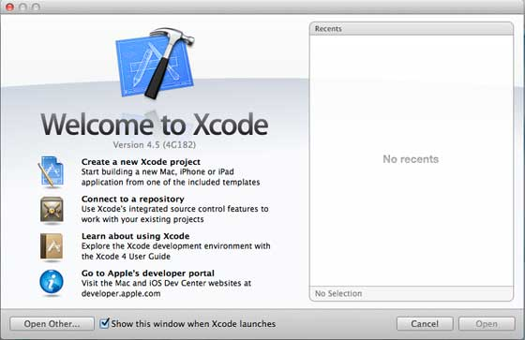
Creating the First App
Topic Objective: Understanding the concept of app creation
Now we are going to create a simple single view application (a blank app) that will run on the iOS simulator.
The steps are as follows.
Step 1 − Open Xcode and select Create a new Xcode project.
Source : https://www.tutorialspoint.com/ios/ios_first_iphone_application.htm

Slide 32
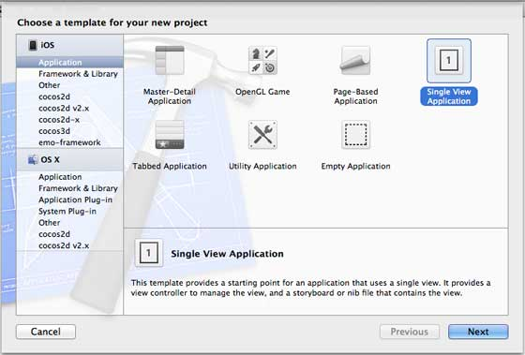
Creating the First App
Step 2 − Select Single View Application.
Source : https://www.tutorialspoint.com/ios/ios_first_iphone_application.htm

Slide 33
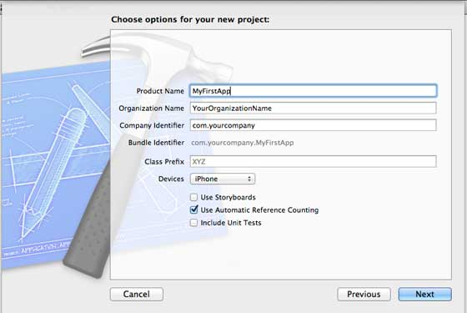
Creating the First App
Step 3 − Enter the product name, i.e., the name of the application, organization name, and then the company identifier.
Source : https://www.tutorialspoint.com/ios/ios_first_iphone_application.htm

Slide 34
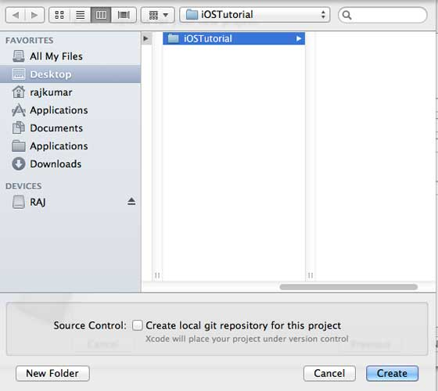
Creating the First App
Step 4 − Ensure that Use Automatic Reference Counting is selected in order to automatically release the resources allocated once it goes out of scope. Click Next.
Step 5 − Select the directory for the project and select create.
Source : https://www.tutorialspoint.com/ios/ios_first_iphone_application.htm

Slide 35
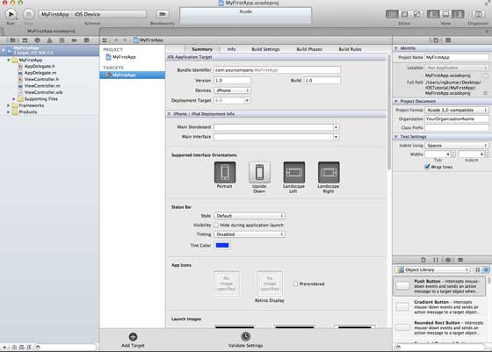
Creating the First App
Step 6 − You will see a screen as follows −
In the screen above, you will be able to select the supported orientations, build and release settings. There is a field deployment target, the device version from which we want to support, lets select 4.3, which is the minimum deployment target allowed now. For now, these are not required and let's focus on running the application.
Source : https://www.tutorialspoint.com/ios/ios_first_iphone_application.htm

Slide 36

Creating the First App
Step 7 − Now, select iPhone simulator in the drop down near Run button and select run.
Source : https://www.tutorialspoint.com/ios/ios_first_iphone_application.htm

Slide 37
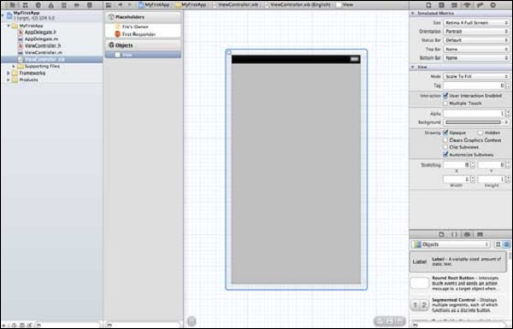

Creating the First App
Step 8 − That's it; you have successfully run your first application. You will get an output as follows −
Now let's change the background color, just to have a start with the interface builder. Select ViewController.xib. Select background option in the right side, change the color and run.
Source : https://www.tutorialspoint.com/ios/ios_first_iphone_application.htm

Slide 38
DAILY QUIZ 3
Which method is used for representing a string. (NS String/ MyString)
2. Which programming language is used in iOS?
Swift and Objective-C
JAVA
PHP
None of the above
3. ___ is an intuitive, fast and general-purpose programming language created by Apple for developing apps for iOS, Mac, Apple Watch and Apple TV.
Swift
JAVA
PHP
All of the above
4. MyClass *objectName = [[MyClass alloc]init] ; Is this true?

Slide 39
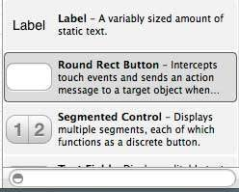
UI Implementation
Topic Objective: Understanding the concept of UI Implementation
Actions and outlets in iOS are referred to as ibActions and ibOutlets respectively, where ib stands for interface builder. These are related to the UI elements and we will explore them after knowing visually how to implement them.
Actions and Outlets – Steps Involved
Step 1 − Let's use our First iPhone Application.
Step 2 − Select the ViewController.xib file from the files in the navigator section.
Step 3 − Now, you can select the UI elements from the library pane in the right hand side of our window, which is shown below.
Source: https://www.tutorialspoint.com/ios/ios_actions_and_outlets.htm

Slide 40
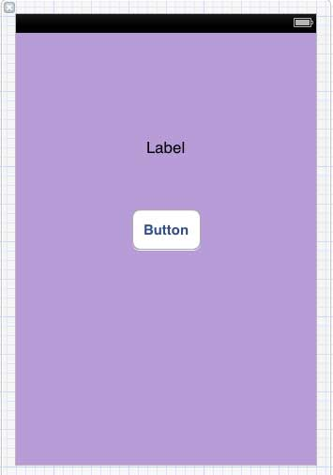
UI Implementation
Step 4 − You can drag and drop the UI elements to our view in our interface builder.
Step 5 − Let us add a Label and Round Rect Button to our view.

Slide 41

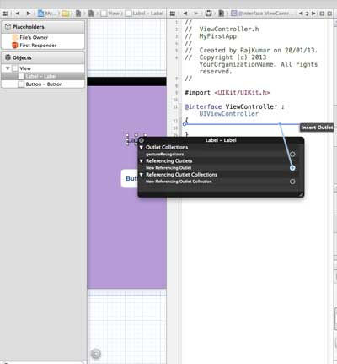
UI Implementation
Step 6 − From the Editor Selector button in the workspace toolbar found on the top right corner as shown below.
Step 7 − We will see two windows in our editor area in the center, one is ViewController.xib file and the other is ViewController.h.
Step 8 − Now, right click on the label and select, hold and drag the new referencing outlet as shown below.

Slide 42
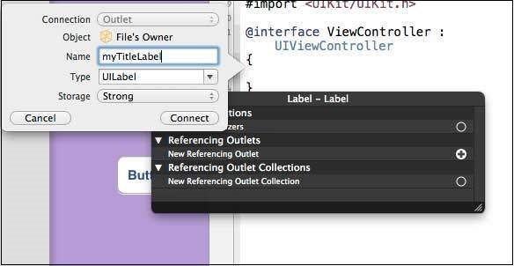
UI Implementation
Step 9 − Drop in the ViewController.h in between the curly braces. In case there are no curly braces in the file, add the ViewController before doing this. You will find a pop-up as shown below.

Slide 43
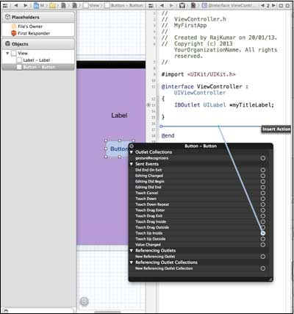
UI Implementation
Step 10 − Type the label name for the outlet, here we have used the label myTitleLabel. Click connect and the ibOutlet will be complete.
Step 11 − Similarly, to add an action, right click the Round rect button, select touch up inside and drag it below the curly braces.
Step 12 − Drop it and name it setTitleLabel.

Slide 44
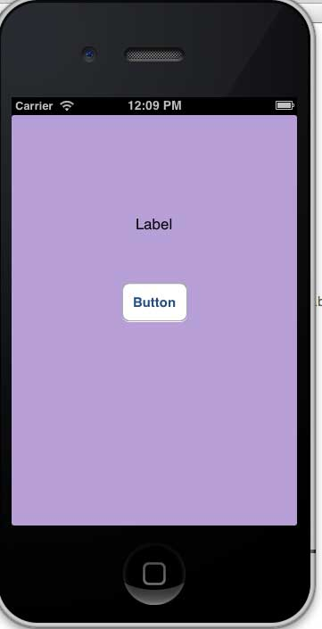
UI Implementation
Output
.

Slide 45
DAILY QUIZ 4
A variably sized amount of static text is known as label/segmented control.
Which is default UI property in iOS atomic/non atomic
3. Which of the framework does not used in iOS
UIKit Framework/ AppKkit Framework

Slide 46
Touch Framework
Topic Objective: Understanding the concept of Touch Framework
Cocoa Touch is a user interface framework provided by Apple for building software applications for products like iPhone, iPad and iPod Touch.
It is primarily written in Objective C language and is based on Mac OS X.
Cocoa Touch was developed based on model view controller software architecture.
The high-level application programming interfaces available in Cocoa Touch help to make animation, networking, and adding the appearance and behavior of the native platform to the developed applications possible with less code development.

Slide 47
UI Implementation: Touch Framework
The main features of Cocoa Touch include:
Core Animation: Helps to create rich user experiences by allowing for the smooth movement of visual elements. It also fills in the interim frames of animation with automatic timing and adjustment.
Core Audio:
Frameworks: Audio and Video, Core Audio, OpenAL, Media Library, AV Foundation, Data Management
Core Data: Provides an object-oriented data management solution and aids in defining an application's data model in a logical and graphical way:
Frameworks: SQLite, Graphics and Animation, Core Animation, OpenGL ES, Quartz 2D, Web Kit, Map Kit etc.

Slide 48
UI Implementation: Touch Framework
Cocoa Touch is made up of several frameworks, but the key ones are: Audio and Video Core Audio
OpenAL
Media Library
AV Foundation
Data Management Core Data
SQLite
Graphics and Animation Core Animation
OpenGL ES
Quartz 2D
Networking and Internet Bonjour
WebKit
BSD Sockets
User Applications Address Book
Core Location
Map Kit
Store Kit

Slide 49
DAILY QUIZ 5
What is not supported in objective C?
Recursive method call
Method argument default value
Variable argument count to method
Byte manipulation
2. How can we return multiple values from functions?
Not possible
Void*
tuple
3. Which of these classes is not a root class?
NSString
NSObject
NSProxy
NSZombie

Slide 50
SQLite : Data Persistence
Topic Objective: To understand about SQLite and features
SQLite is an in-process library that implements a self-contained, zero-configuration, serverless, transactional SQL database engine. The source code for SQLite exists in the public domain and is free for both private and commercial purposes.
SQLite has bindings to several programming languages such as C, C++, BASIC, C#, Python, Java and Delphi. The COM (ActiveX) wrapper makes SQLite accessible to scripted languages on Windows such as VB Script and JavaScript, thus adding capabilities to HTML applications. It is also available in embedded operating systems such as iOS, Android, Symbian OS, Maemo, Blackberry and WebOS because of its small size and ease of use.

Slide 51
Cont…….
SQLite is atomicity, consistency, isolation, durability (ACID) compliant. This embedded relational database management system is contained in a small C programming library and is an integral part of client-based applications. SQLite uses a dynamic SQL syntax and performs multitasking to do reads and writes at the same time. The reads and writes are done directly to ordinary disk files.
An SQLite library is called dynamically, and application programs use SQLite functionality through simple function calls, reducing latency in database access. These programs store entire databases as single cross-platform files on host machines. This simple design is implemented by locking the entire database file during a write.

Slide 52
DAILY QUIZ 6
1. What is KVO?
Key variable obfuscation
Key value operations
Key value observing
2. What can you use to avoid the msgSend function overhead?
IMP
SEL
You can’t use anything
None of these
3. What is the name of the type of SQL Database that iOS Supports?
SQLite
SQL
Mysql
Nosql

Slide 53
MapKit
Topic Objective: To understand about Mapkit, WiFi calendar
Display map or satellite imagery within your app, call out points of interest, and determine placemark information for map coordinates.
MapKit Framework is used to:
Embed maps directly into your app’s windows and views.
Add annotations and overlays to a map for calling out points of interest.
Provide text completion to make it easy for users to search for a destination or point of interest.
Essentials:
More info: Source: https://developer.apple.com/documentation/mapkit/
class MKMapView
An embeddable map interface, similar to the one that the Maps app provides.
class MKMapItem
A point of interest on the map.
struct Map
A view that displays an embedded map interface.

Slide 54
Integrating calendar and address book with social media application
– Using Wifi – iPhone marketplace
Integrating applications with social networking sites are becoming popular which is attracting more developers. In such a context, the application developed has a great demand. This application can be useful for students and those who are fond of using Facebook. The application has some important features of Facebook, such as a post-onwall, view news feed or checking a friend’s birthday, so the user does not have to go through the Facebook page for these functions. The procedures that were taken during the application have been documented in detail, so the thesis can be used as a guide for developers, and those who have interest in how integration is done can have a glance at it.
https://www.theseus.fi/bitstream/handle/10024/49257/Lakoul_Nidhi.pdf?isAllowed=y&sequence=1

Slide 55
Introduction to swift
Topic Objective: To understand about SWIFT and features
Swift is a powerful and intuitive programming language for iOS, iPadOS, macOS, tvOS, and watchOS. Writing Swift code is interactive and fun, the syntax is concise yet expressive, and Swift includes modern features developers love. Swift code is safe by design, yet also produces software that runs lightning-fast.
Open Source
Swift is developed in the open at Swift.org, with source code, a bug tracker, forums, and regular development builds available for everyone. This broad community of developers, both inside Apple as well as hundreds of outside contributors, work together to make Swift even more amazing. There is an even broader range of blogs, podcasts, conferences and meetups where developers in the community share their experiences of how to realize Swift’s great potential.

Slide 56
Introduction to swift
Cross Platform
Swift already supports all Apple platforms and Linux, with community members actively working to port to even more platforms. With SourceKit-LSP, the community is also working to integrate Swift support into a wide-variety of developer tools. We’re excited to see more ways in which Swift makes software safer and faster, while also making programming more fun.
Swift for Server
While Swift powers many new apps on Apple platforms, it’s also being used for a new class of modern server applications. Swift is perfect for use in server apps that need runtime safety, compiled performance and a small memory footprint.

Slide 57
Swift Features
Some of the features that make Swift a modern language include:
Clean syntax, which makes code readable and easier to work with
Optionals, a new way of expressing when a value may not exist
Type inference, which speeds up development and allows the compiler to help identify common issues
Type safety, which enforces code that’s less likely to crash your program
Automatic Reference Counting (ARC) for memory management, which automatically handles some of the deeper technical challenges of native programming

Slide 58
Swift Features
Tuples and multiple return values, which allow smaller units of code to do more
Generics, which help developers write code that can be used in multiple scenarios
Fast and concise iteration over collections, making Swift a fast language
Structs that support methods, extensions, and protocols, which allow Swift to optimize for memory use and speed while providing flexibility for developers
Map, filter, reduce, and other functional programming patterns, which simplify code and streamline common actions that previously required multiple lines of code
Powerful error handling, which helps the developer write fewer bugs and better handle scenarios that could cause apps to crash or perform unexpectedly

Slide 59
DAILY QUIZ 7
1. Which of the following is true about Swift?
Swift is an open-source programming language
Swift is used in iOS development
Swift can be compiled as a dynamic framework
All of the above
2. Swift is an open-source programming language developed by?
Google
Facebook
Apple
IBM
3. What is the meaning of question mark "?" in Swift?
used in function declaration
used in property declaration
used in loop declaration
used in parameter declaration

Slide 60
DAILY QUIZ 8
1. How can you make a property optional in Swift?
You have to declare a question mark & in the code to make a property optional
You have to declare a question mark ? in the code to make a property optional
You have to declare a question mark ?? in the code to make a property optional
None of the above.
2. In Swift4, functions can be categorized in __________ types.
1
2
3
4
3. A function inside a function is called a nested function in swift?
TRUE
FALSE
Can be true or false
Can not say

Slide 61
DAILY QUIZ 9
1. Enum is also known as Swift Enumeration.
Yes
No
Can be yes or no
Can not say
2. Constants are declared by using _____ keyword and variables by _______ keyword.
var, let
let, let
var, var
let, var
3. Which of the following is not a literals in swift?
Binary Literals
Quad Literals
Hexadecimal Literals
Decimal Literals

Slide 62
WEEKLY ASSIGNMENT
What Are Enumerations in Swift?
What is Swift? How is it different from Objective-C?
What is Inheritance in Swift?
What are the most important features of IOS?
What is a dictionary in Swift?
Explain the Architecture of iOS.
What do you mean by property in iOS?
What are different types of iOS Application States?
What is an iOS developer and what are his responsibilities?
State the difference between Android and iOS.

Slide 63
TOPIC LINKS
https://www.gkgigs.com/list-apple-ios-version-history
https://www.lifewire.com/ios-versions-4147730
https://www.tutorialspoint.com/ios/ios_first_iphone_application.htm
https://www.tutorialspoint.com/ios/ios_actions_and_outlets.htm
https://developer.apple.com/documentation/mapkit/
https://www.theseus.fi/bitstream/handle/10024/49257/Lakoul_Nidhi.pdf?isAllowed=y&sequence=1

Slide 64
MCQ
1. Which of the following is Application development environments for iOS?
Cocoa
Cocoa touch
Cocoa iOS
Cocoa begin
2. Cocoa touch used to refer the application development using any programmatic interface?
TRUE
FALSE
Can be true or false
Can not say
3. Which JSON framework is supported by iOS?
UIKit
Django
SBJson
UCJson

Slide 65
MCQ
4. ___________ is a two-part string used to identify one or more apps from a single development team.
bundle ID
app ID
team ID
All of the above
5. In Which state the app is running in the foreground and is receiving events?
Not running
Inactive
Background
Active

Slide 66
MCQ
6. Which of the following features of Swift programming language?
Swift is very easy to learn and precise to use
Automatic memory management
Swift follows Objective-C like syntax
All of the above
7. In Swift programming language, single-line comments are started with ___________?
single slashes
double slashes
Asterisk
hash
8. _____________ is a process of querying and calling properties
Lazy Chaining
Swift Chaining
Optional Chaining
All of the above

Slide 67
MCQ
9. How many types of classes in Inheritance in Swift?
1
2
3
4
10. Which Of The Following Is Incorrect Data Type In SWIFT ?
Uint
Double
Char
Optional

Slide 68
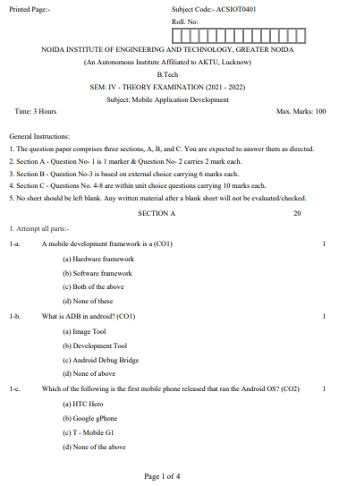
Old University Exam Question Paper

Slide 69
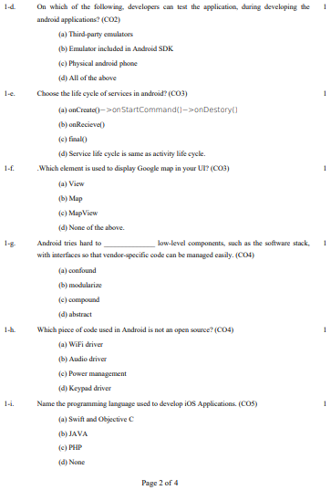
Old University Exam Question Paper

Slide 70
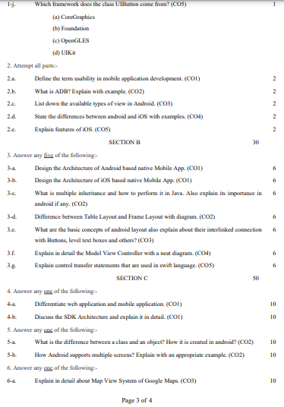
Old University Exam Question Paper

Slide 71
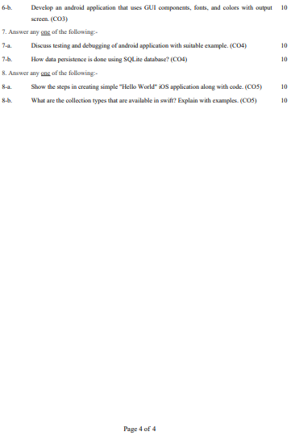
Old University Exam Question Paper

Slide 72
Expected Questions
What are the tools that are required to develop iOS applications?
What are the most important features of swift?
Explain the common execution states for a swift iOS App (iOS Application Lifecycle).
What type of objects are basic data types in swift?
What are the control transfer statements that are used in iOS swift?
What is the difference between Let and Var in swift?
What is the use of double question mark “??” in swift?
What are the collection types that are available in swift?
What is Tuple? How to create a Tuple in swift?
What are the Higher-Order functions in swift?

Slide 73
Recap/Summary
Understood key concepts of iOS and features.
Know the basics of Objective C.
To understand the concept of UI implementation and touch frameworks
To understand the concept of various applications like location based, calendar, address book integration with social media application
To know about introduction to Swift and features.

Slide 74
Noida Institute of Engineering and Technology, Greater Noida
THANK YOU !!

